Slide 1
Executive data

Slide 2
Executive summary best practice
Situation
Setting the situation and background
Complication
Identify problem(s) or opportunity
Question
State hypothesis
Answer
Propose solution and discuss impact
A good executive summary provides all the key information in one slide
Consultants typically communicate in a “top down” or pyramid fashion, starting with the conclusion and then providing the supporting information
The goal is to communicate as much information in as few words as possible

Slide 3
What is the most important number or metric to share with the client? What impact would the model have on the client’s bottom line?

Slide 4
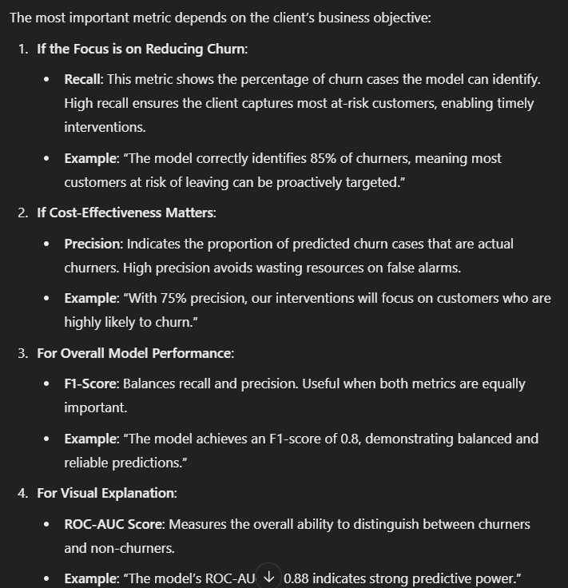

Slide 5
